Slide 1

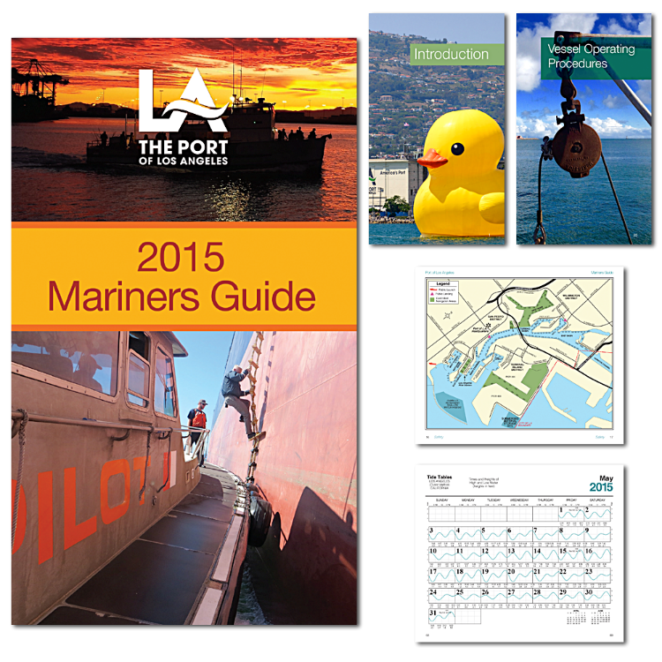
Port of
Los Angeles
2015 Mariners Guide
Directories/Handbook

